Slide 1
“IMPACT IMPROVEMENT OF FRONTAL BUMPER PIPE USING PLA MATERIAL AND 3D PRINTING TECHNOLOGY WITH WASTE PLASTIC”

Slide 2
ABSTRACT
In recent years, the safety improvement of the vehicles is important as well as the engine performance and fuel consumption is also important. The customers are mainly focus on the fuel efficiency and safety rating of the car. There are many cars available in markets which has low safety ratings by global NCAP test. So decide to focus on the frontal impact of the car by improving the shock absorbing capacity of the vehicle.

Slide 3
We can use recycled waste plastic material to improve the impact and increase the shock absorbing capacity of the frontal bumper because of density of the plastic. Plastic material is light weight compare to the metals so that not affect to the vehicle weight and engine performance. Design the different types of 3D printing structure in CATIA by refereeing frontal bumper hollow pipe. Install that plastic structure into hollow pipe and perform the dynamic analysis on the all structure. Find out best structure by checking reaction force of the structure. Perform the UTM testing to validate the results.

Slide 4
PROBLEM STATEMENT
Traditionally, front-end modules consisted of hefty steel carriers. But with the growing focus on reducing the weight of the vehicles in the past few years has led to increasing usage of lightweight composites, instead of steel and iron, for the structural carriers of FEMs.
The main 3D printing material used is plastic, although some metals can also be used for 3D printing. However, plastics offer advantages as they are lighter than their metal equivalents.
This is particularly important in industries such as automotive and aerospace where light-weighting is an issue and can deliver greater fuel efficiency. Also, parts can be created from tailored materials to provide specific properties such as heat resistance, higher strength or water repellence.

Slide 5
OBJECTIVES
Strength improvement of the frontal bumper for impact improvisation.
3D modelling of the metal hollow pipe used in vehicle front bumper with different 2 types of plastic structure.
Perform the dynamic analysis on the hollow pipe.
Perform the dynamic analysis of the hollow pipe with different plastic structure.
Study on the 3D printing technology and material properties of PLA.
Experimental validation of the optimized 3D printing structure with the help of universal testing machine.

Slide 6
METHODOLOGY
Stage 1
In this semester we started the work of this project with literature survey.
Gathered many research papers which are relevant to this topic
Stage 2
After gathered research paper we describe literature gap on, and identify need of project.
Then started work on concept design with the help of literature survey market survey.
Stage 3
After finalizing concept 3D model of project, we started work on material selection design and also discuss about component.
After deciding the components, the 3D Model and drafting will be done with the help of CATIA software.

Slide 7
Stage 4
The Analysis of the components will be done with the help of ANSYS using FEA.
The experimental observations will be taken on compenent.
Stage 5
Meshing the CAD model and applying the boundary conditions.
Stage 6
Fabrication of specimen
Solve for the solution of meshed model using ANSYS.
Suitable experimentation
Validation of result by comparing with software results.

Slide 8
OVERVIEW
Over the past year, Global NCAP has released the results of more models, most recently of the Hyundai Santro, Datsun Redigo and Maruti's Ertiga and Wagon R. While the results have reached far and wide (God bless the internet), a look at online forums and social media chatter also suggests there’s a lot of misinformation about the crash tests. So, it’s a time as good as any to break it right down.

Slide 9
GLOBAL NCAP TEST
NCAP stands for New Car Assessment Program. To give a brief background, in 1978 USA became the first country to come up with a programme to provide car crashworthiness information to consumers, which eventually expanded to crash testing and reporting the results.
The US-NCAP model formed the basis for similar programme in other regions, and today there is the Australasian NCAP, Euro NCAP, Japan NCAP, ASEAN NCAP, China NCAP, Korean NCAP and Latin NCAP.
Global NCAP, an independent charity registered in the UK, was formed in 2011 to enhance cooperation between the various NCAPs and primarily promote vehicle crash-testing and reporting in emerging markets. ‘Safer Cars For India’ and ‘Safer Cars For Africa’ are its key initiatives at the moment.

Slide 10
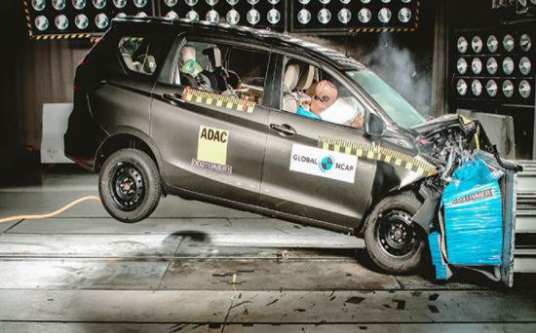
CRASH TEST

Slide 11
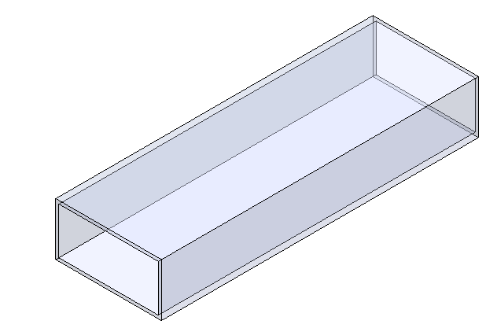
3D MODELLING OF THE FRONT BUMPER RECTANGULAR PIPE

Slide 12
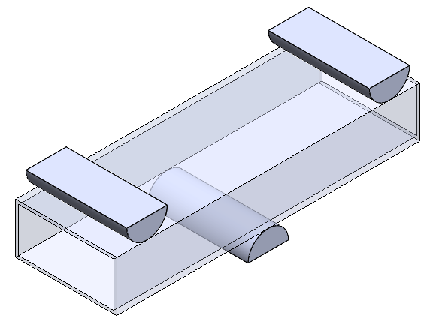
3D MODEL FOR THE FEA

Slide 13
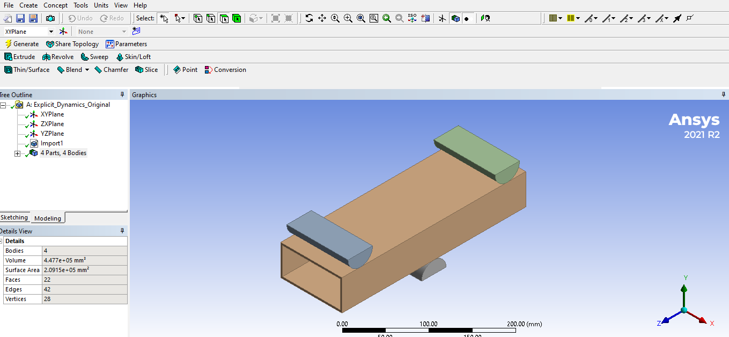
FINITE ELEMENT ANALYSIS

Slide 14
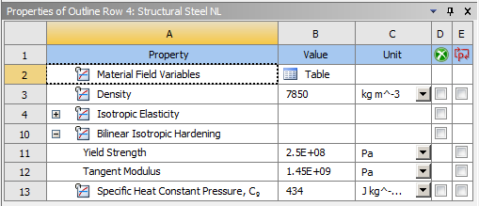
MATERIAL PROPERTIES For Original

Slide 15

Original Weight

Slide 16
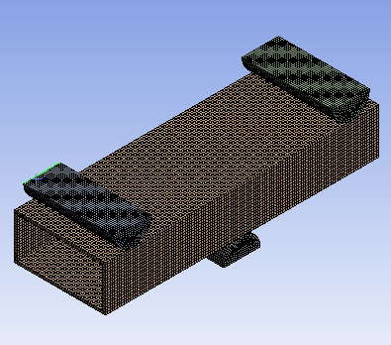
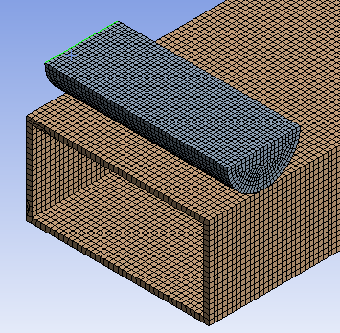
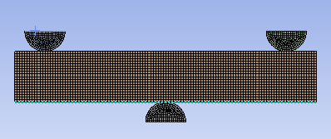

MESH

Slide 17
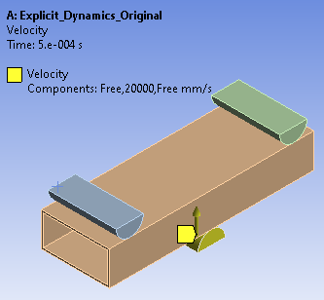
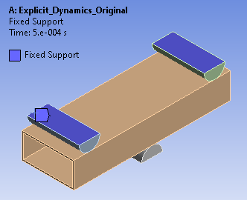
BOUNDARY CONDITION

Slide 18
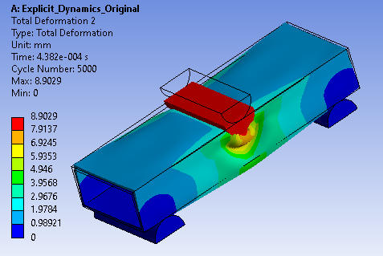
RESULTS-: Total deformation

Slide 19
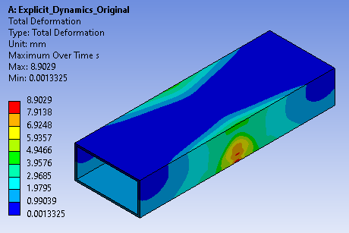
RESULTS-: Total Deformation in Bumper

Slide 20
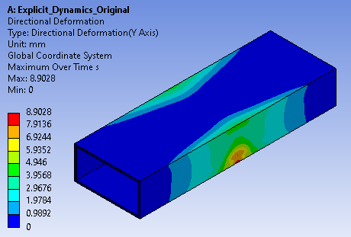
RESULTS:- Direction deformation at y direction

Slide 21
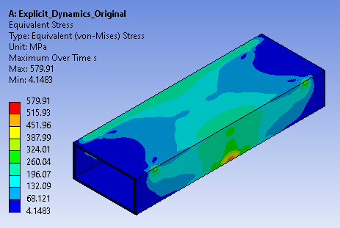
RESULTS-:Equivalent stress generated on the front bumper pipe

Slide 22
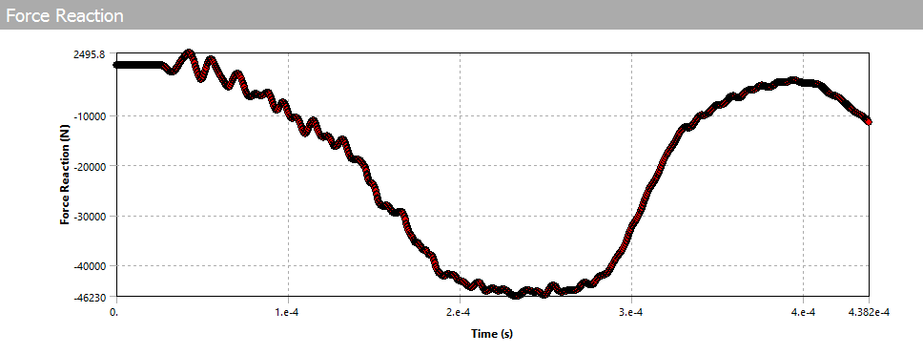

RESULTS-: Reaction force

Slide 23
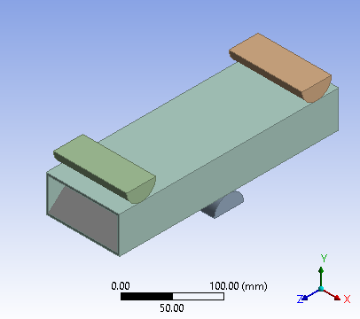
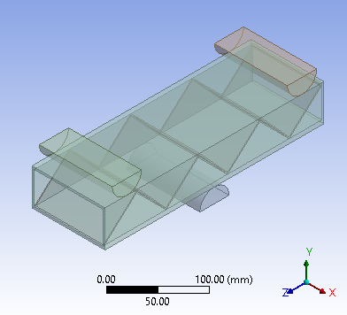
Zig zag Shape PLA

Slide 24
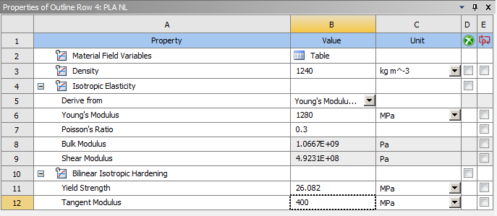
MATERIAL PROPERTIES FOR PLA

Slide 25

Weight of PLA Material

Slide 26
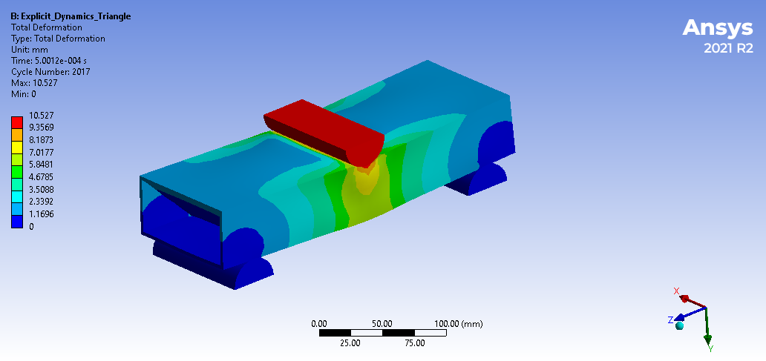
RESULTS-: Total deformation

Slide 27
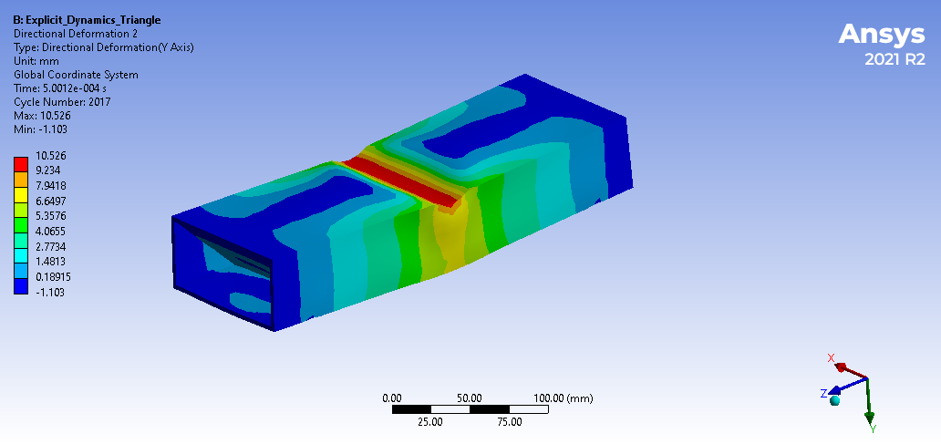
RESULTS-: Total Deformation in Bumper

Slide 28
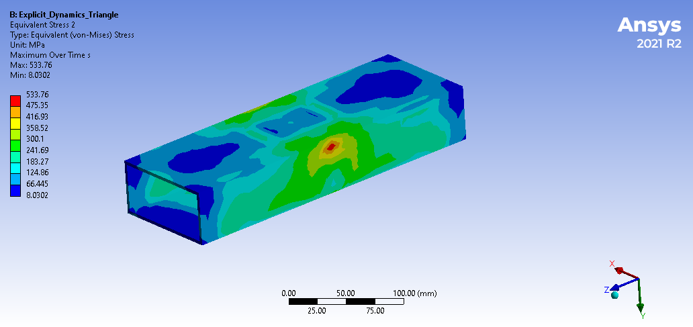
RESULTS-:Equivalent stress generated on the front bumper pipe

Slide 29
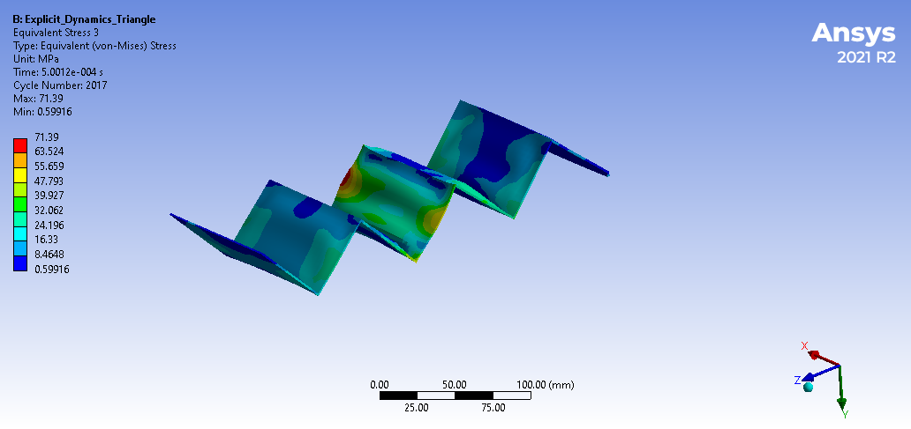
RESULTS-:Equivalent stress generated on the front bumper Zig Zag Shape

Slide 30
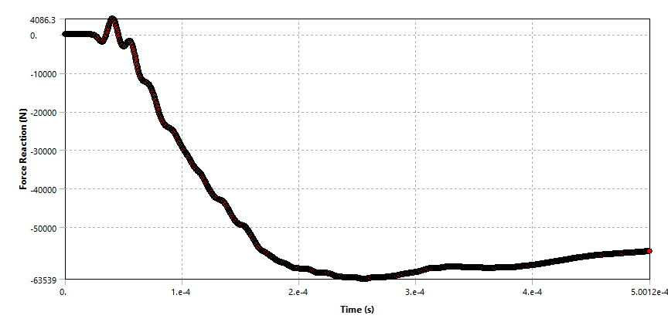

RESULTS-: Reaction force

Slide 31
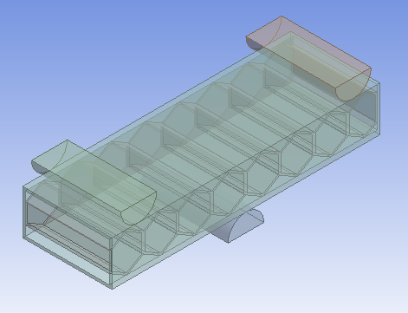
Honeycomb Shape PLA

Slide 32

Weight of PLA Material

Slide 33
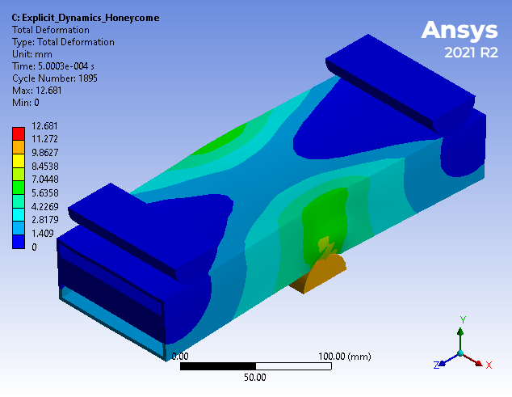
Result : Total Deformation

Slide 34
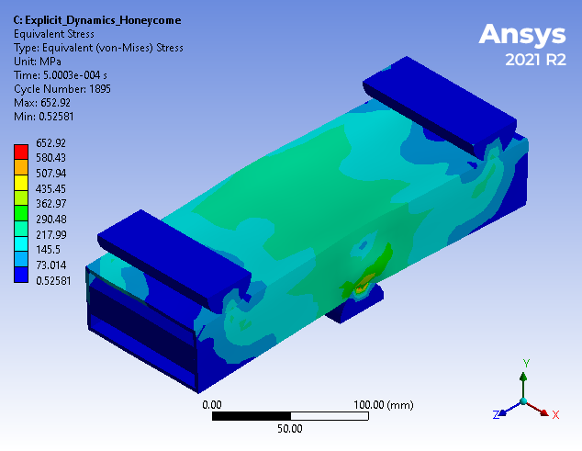
Result : Total Deformation in Bumper Pipe

Slide 35
Result : Equivalent stress generated on the front bumper pipe

Slide 36
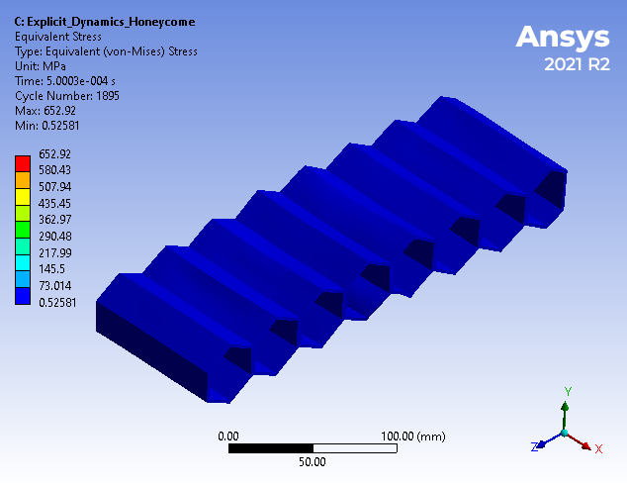
Results : Equivalent stress generated on the front bumper Honeycomb Shape

Slide 37
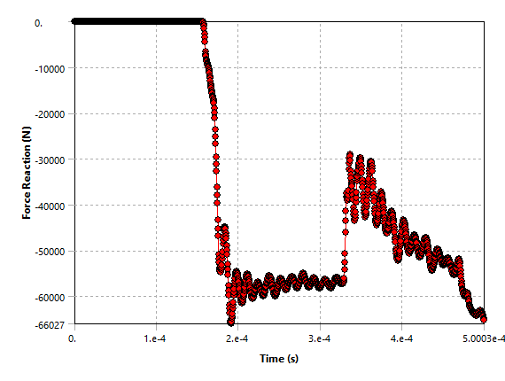

Result : Reaction Force

Slide 38
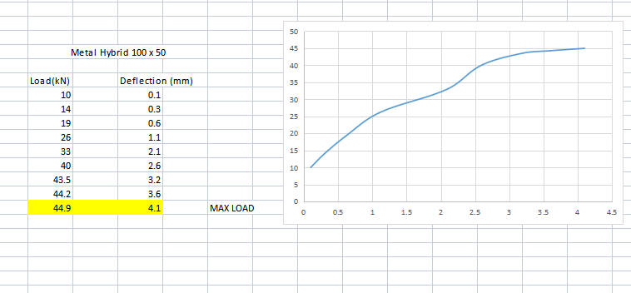
EXPERIMENTAL TEST RESULTS

Slide 39
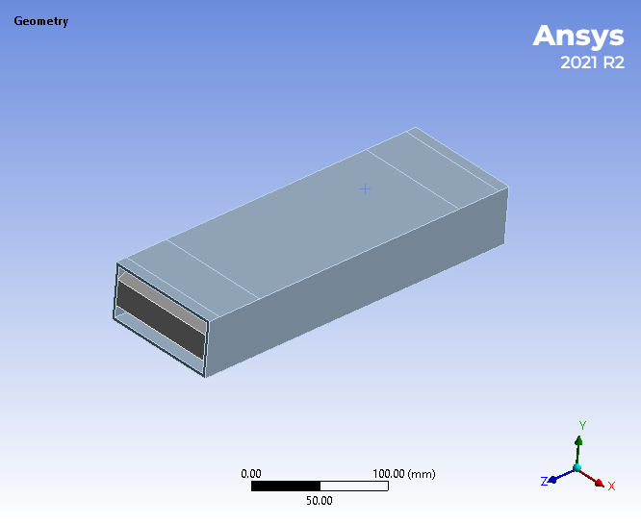
EXPERIMENTAL FEA

Slide 40
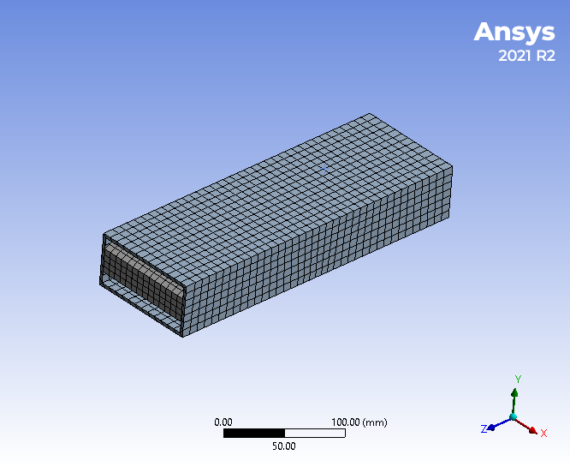

MESHING

Slide 41
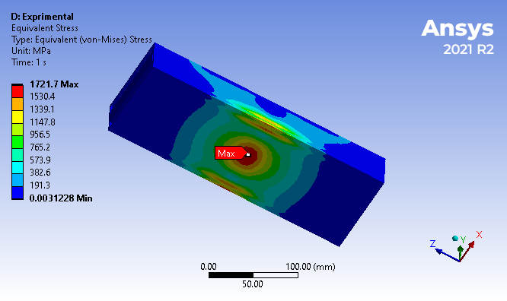
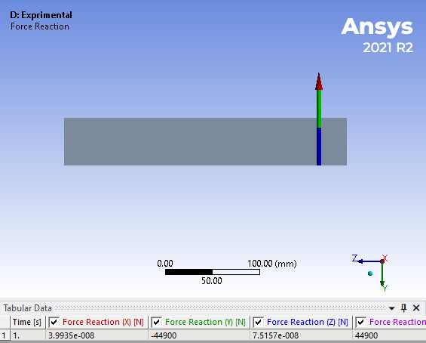
RESULTS

Slide 42
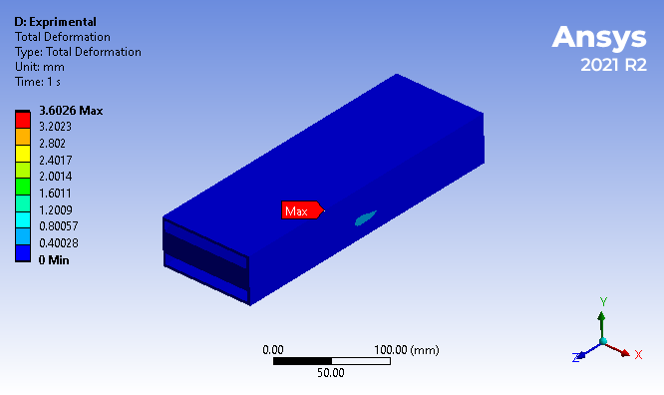
DEFROMATION RESULT

Slide 43
CONCLUSION
In this project, studied on the 3D printing technology and pipes use for the front bumper for impact improvisation.
Developed the literature survey on the bumper and metal plastic hybrid.
Developed the 3D cad model of front bumper rectangular pipe using CATIA software.
Performed the explicit dynamic analysis on the front bumper pipe using ANSYS software and find out the reaction force of the bumper without plastic stiffeners.
The reaction force of the existing bumper is 46230 N and the negative direction shows the direction.
As per dynamic analysis the force reaction observed on the existing front bumper pipe is 46230N. To increase the shock absorbing capacity of the bumper add zig zag structure into the pipe.

Slide 44
CONCLUSION
As per dynamic analysis the reaction force is observed 63539N. Which is grater than the existing model.
So the optimize model is more shock absorbing capacity as compare to the existing model.
The equivalent stress and total deformation observed on the model is 580 MPa and 8.9 mm.
The Zig zag structure have a 533N/mm² stress .

Slide 45
EXPERIMENTAL CONCLUSION
As per Experimental testing after applying the load of the 44.9K the deformation observed is 4.1 mm in the pipe.
As per static analysis we applied the load on the same load as experimental testing and check out the deformation to validate the result.
The deformation observed in the FEA is 3.6 mm.

Slide 46
Total Analytical and Experimental Deformation

Slide 47
REFERENCES
“Crash analysis of a passenger car bumper assembly to improve design for impact test” by Mohammed Abdul Basith, N. Chandrashekar Reddy, Sudhakar Uppalapati, S.P. Jani. 2214-7853/ 2020 Elsevier Ltd.https://doi.org/10.1016/j.matpr.2020.08.561.
“3D printing as an enabling technology to implement maritime plasticCircular Economy” by J. Garrido, J. Saez, J.I. Armesto, A.M. Espada, D. Silva, J. Goikoetxea, A. Arrillaga. Procedia Manufacturing 51 (2020).
“Design and manufacture of automotive composite front bumper assemble component considering inter-facial bond characteristics between overmolded chopped glass fiber polypropylene and continuous glass fiber polypropylene composite” by Sung-Jun Jooa , Myeong-Hyeon Yua , Won Seock Kimb , Jong-Wook Leeb , Hak-Sung Kim. https://doi.org/10.1016/j.compstruct.2019.111849 Received 4 March 2019.
“Design improvements of vehicle bumper for low speed impact” by Neraj Natarajan, Preeti Joshi , R.K. Tyagi. https://doi.org/10.1016/j.matpr.2020.08.212 2214-7853/ 2020 Elsevier Ltd. All rights reserved.
“Large core plastic planar optical splitter fabricated by 3D printing technology” by VáclavPrajzler, Pavel Kulha, Marian Knietel, HerbertEnser. http://dx.doi.org/10.1016/j.optcom.2017.04.070 Received 1 March 2017.
“Metal-plastic hybrid 3D printing using catalyst-loaded filament and electroless plating” by Jing Zhan, Takayuki Tamura , Xiaotong Li , Zhenghao Ma, MichinariSone,MasahiroYoshino, ShinjiroUmezu, HirotakaSato. https://doi.org/10.1016/j.addma.2020.101556 Received 20 February 2020.

